Slide 1

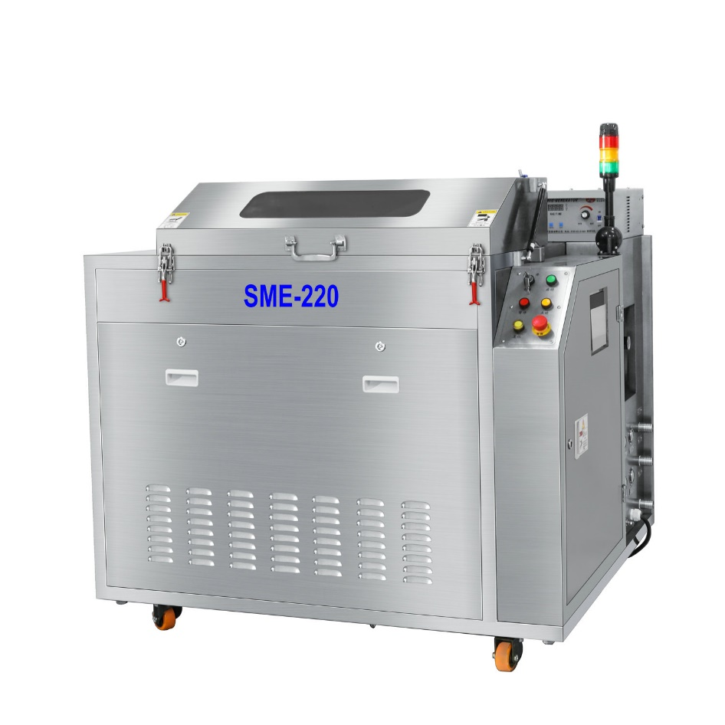
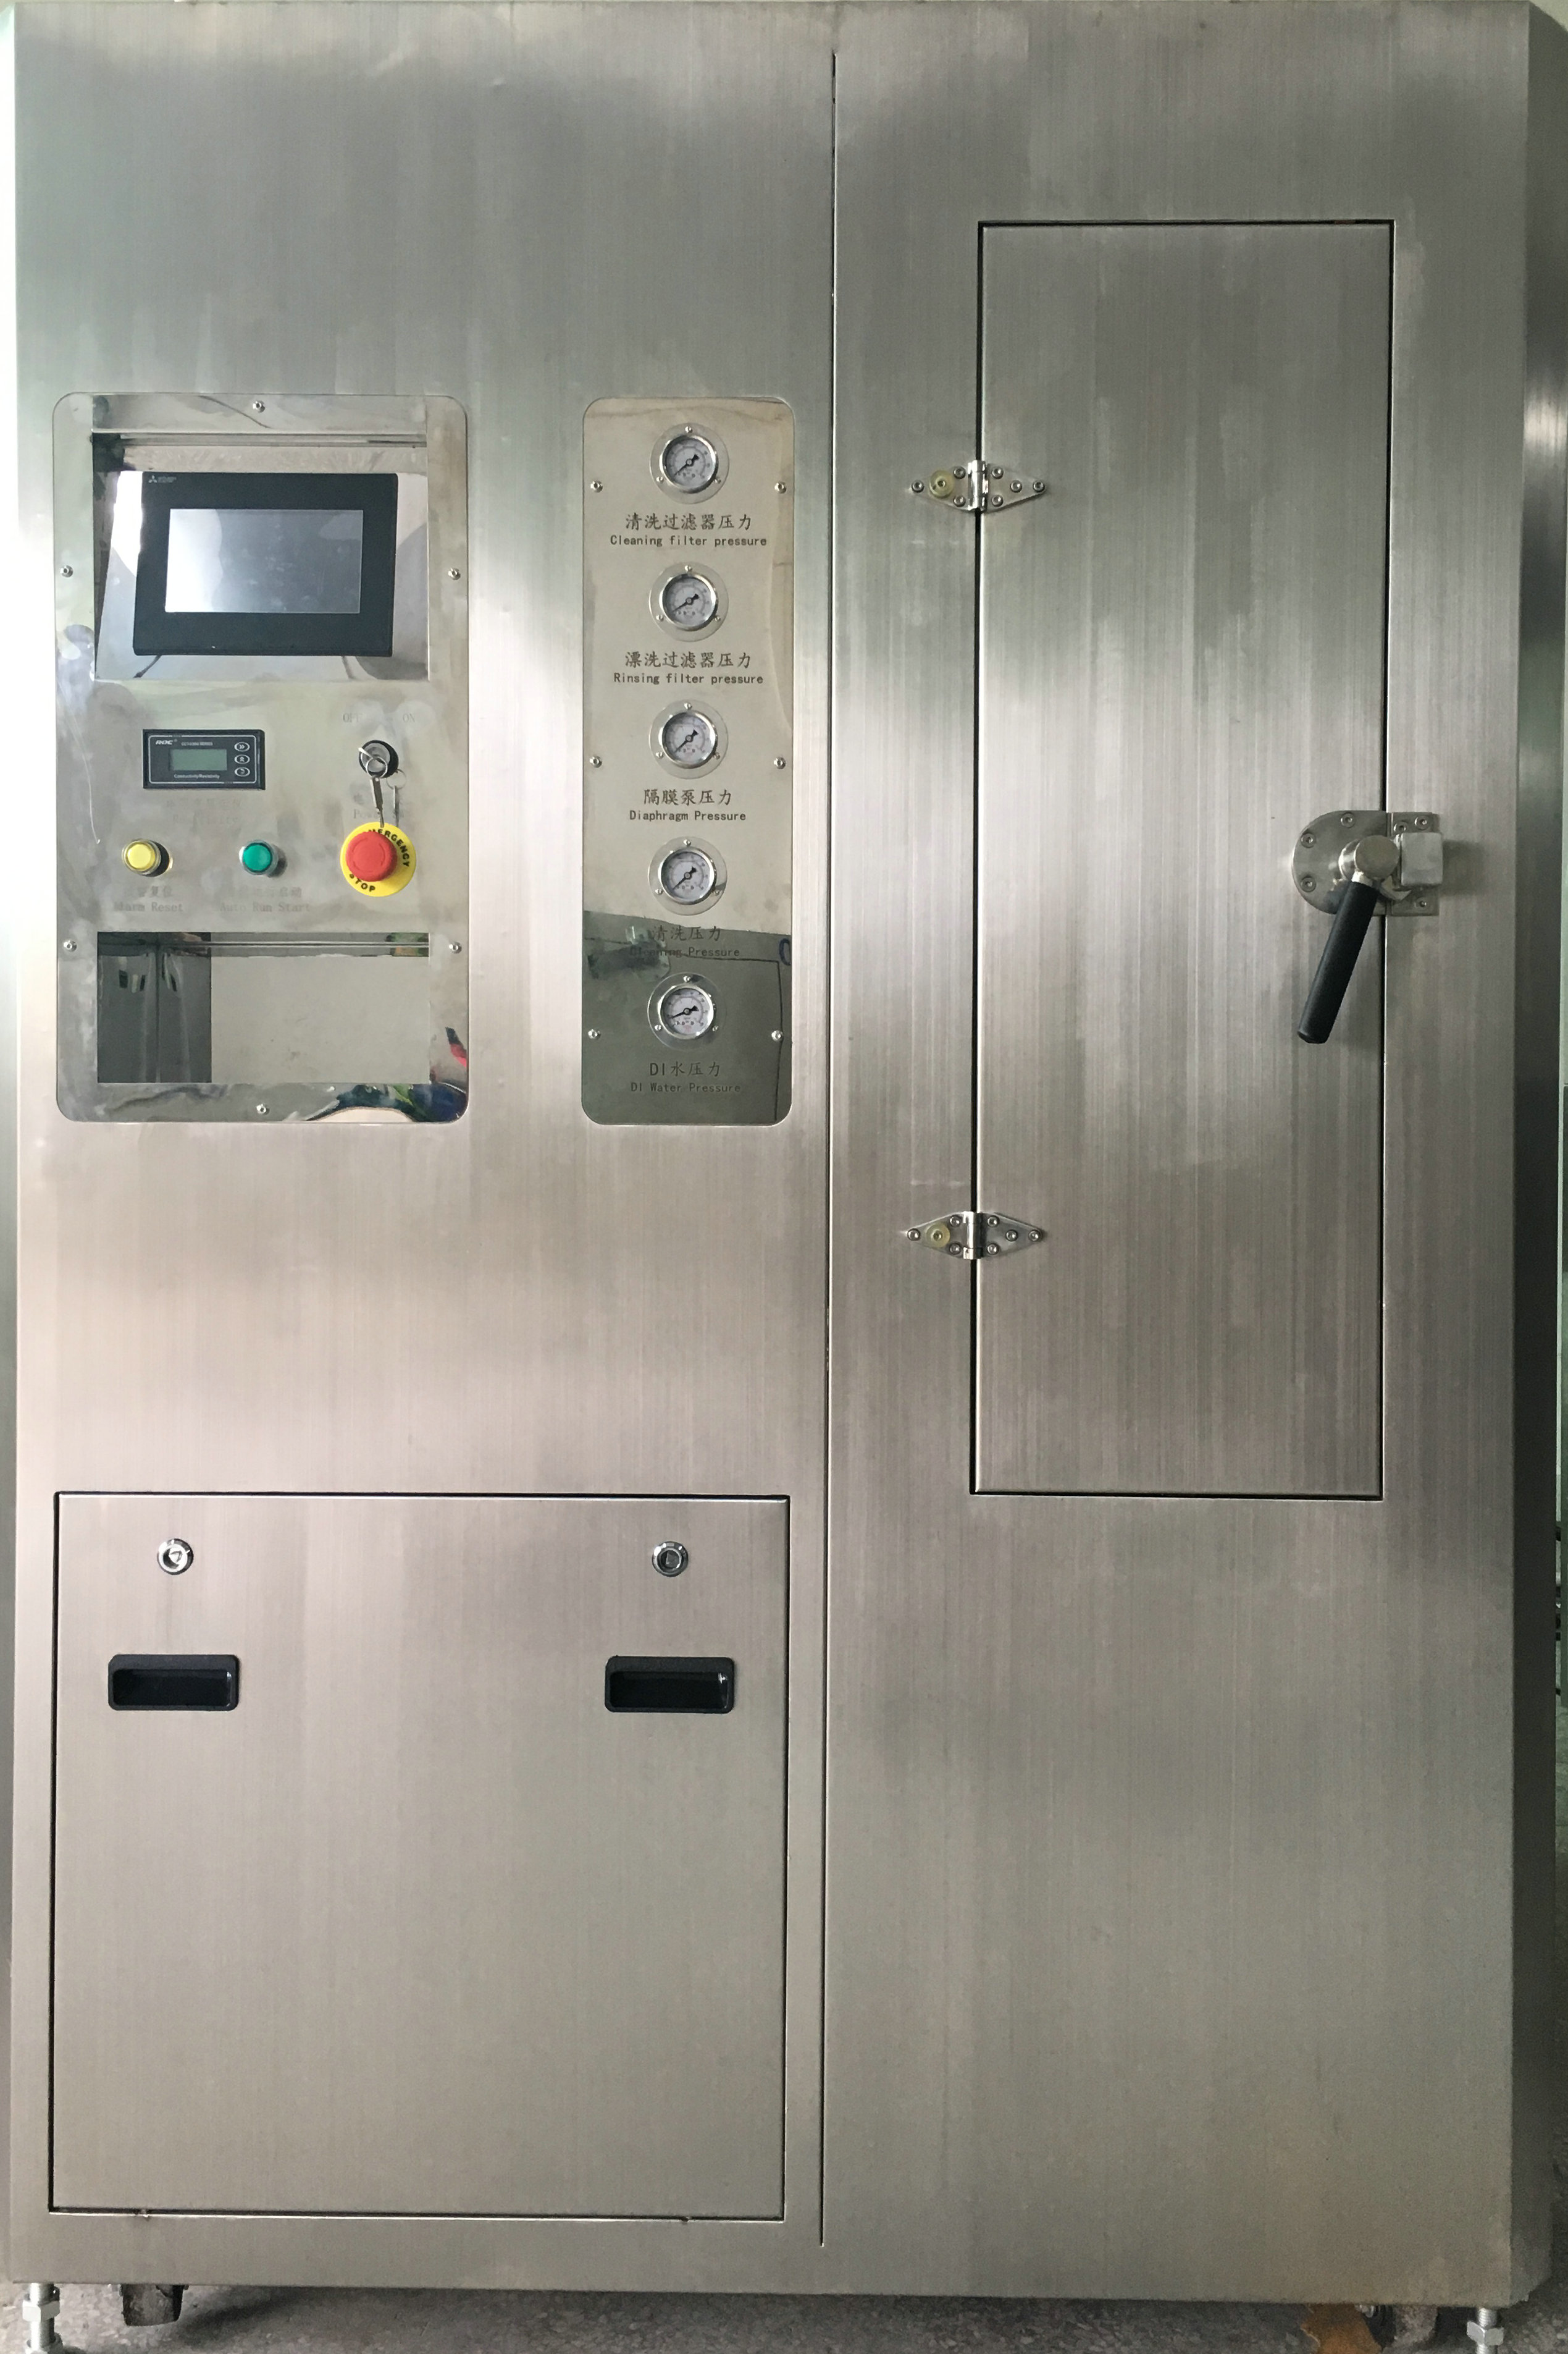
Squeegee Cleaning Machine
Model:SME-220

Slide 2
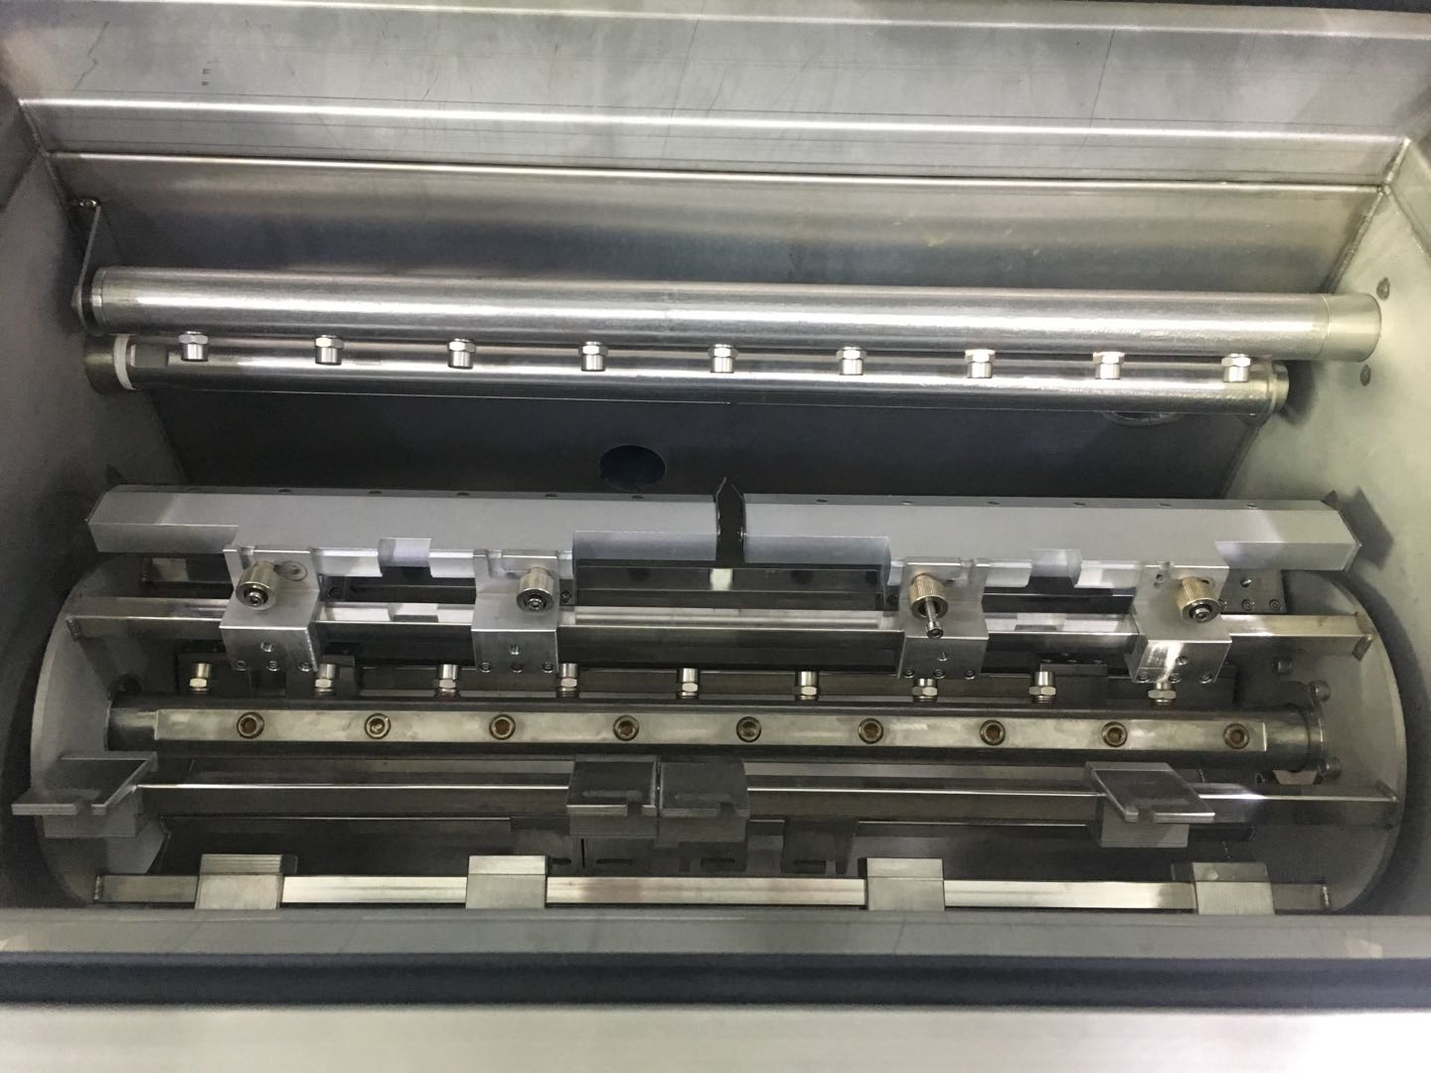
SME-220 Introduction
Cleaning Room
1.Ultrasonic clean+Spray very good cleaning result, especailly gaps and corners of squeegees.
2.Rotation cleaning, 6 pcs of squeegees one time.
3.Squeegees are easy and convienent to laod and unlaod.

Slide 3
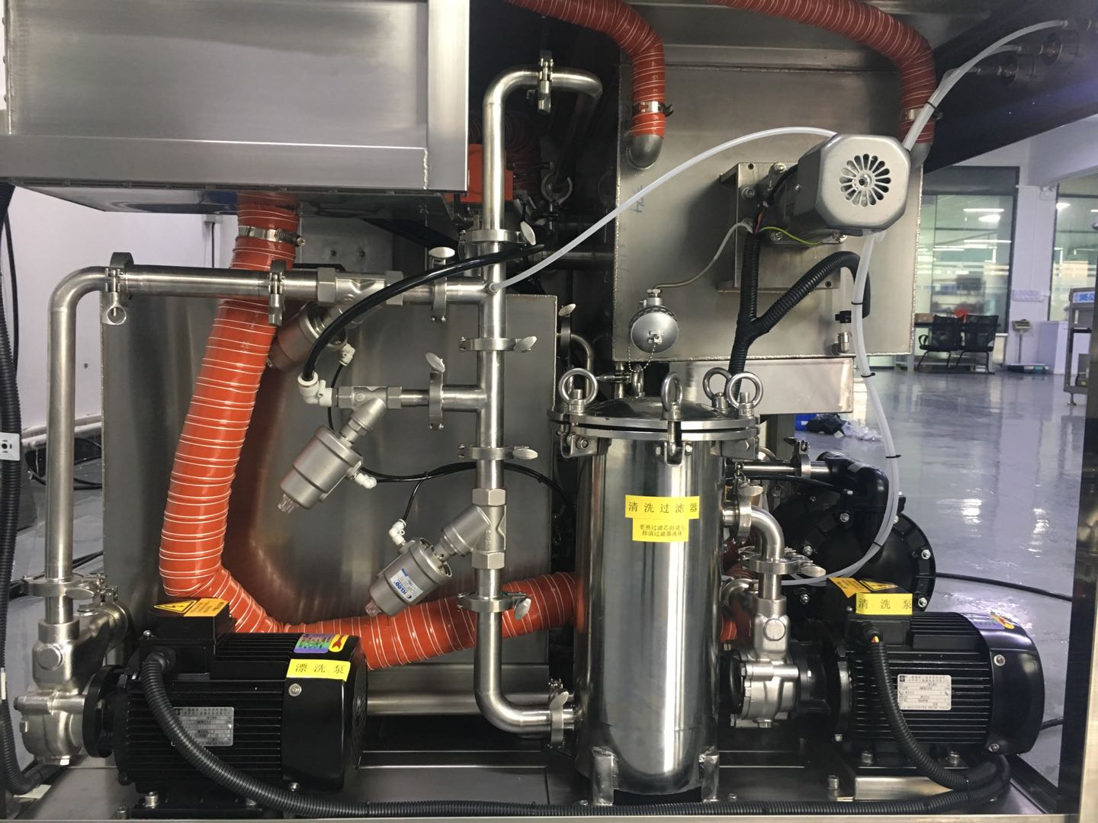
SME-220 Introduction
Cleaning pump,Rinse pump,Air pump
High quality electric clean pump and rinse pump.
ARO air pump, liquid and water add and discharge automatically.

Slide 4

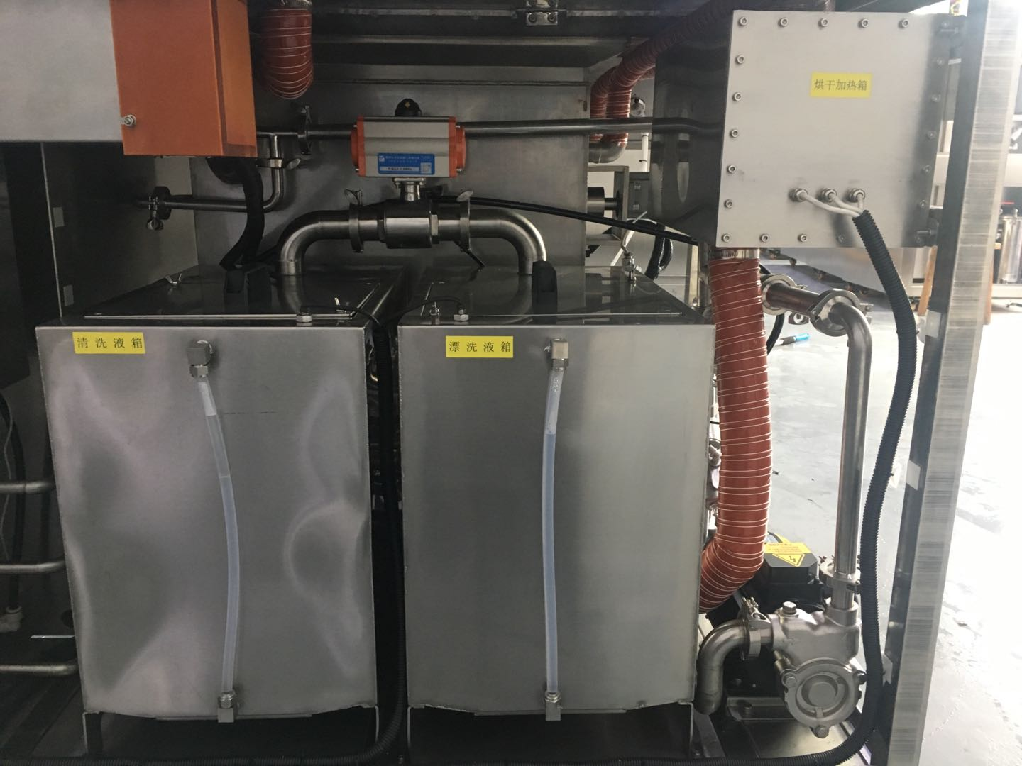
SME-220 Introduction
Fliter system, Liquid tank and Water tank
Real time precise cleaning filter +rinse filter, no solder balls comes back to surface of squeegees again.
Clean liquid and rinse water are recirculation used.
Both cleaning tank and rinse tank have liquid level,heat and temperature control function,protect pumps,heaters and make clean easier and more efficent.

Slide 5
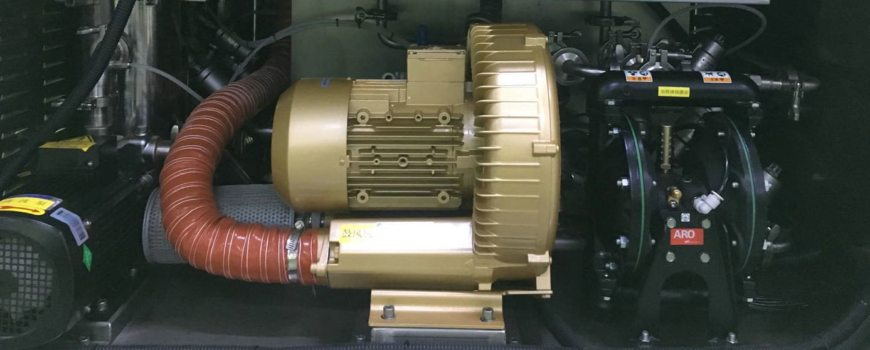
SME-220 Introduction
Air Blower and Pipe system
2.2KW high pressure air blower,greatly improve squeegees dry efficent.
SUS304 stainless steel pipes, angle valves. Nver use plastic pipe, no need to worry about any leak of the system.

Slide 6
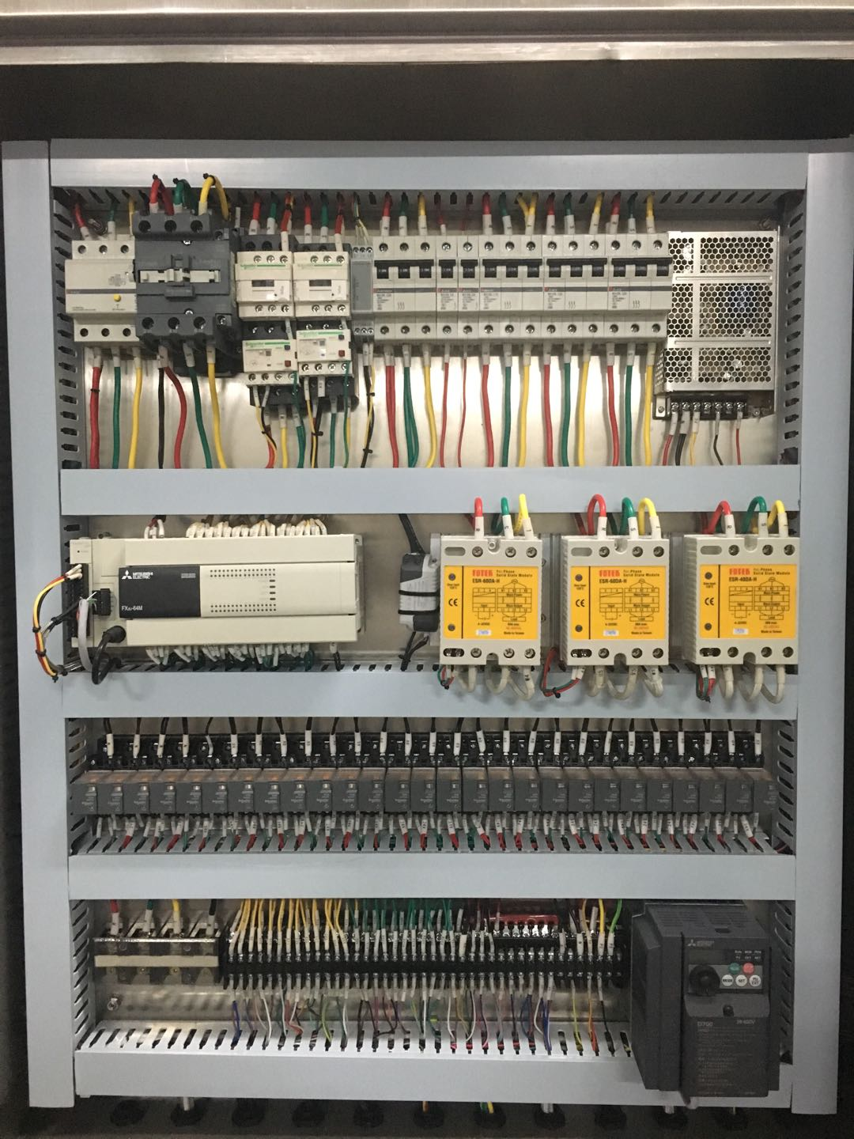
SME-220 Introduction
All Famous brand electric devices
Mitusbishi PLC, Touch panel, Inventer, Modular, Breakers；
Schneider Relays,AC/DC contactors, Overheat contactors.；
Omron Power, Sensor, Fotek SSR；
Pallite Indicators, IDEC buttons, CKD solenoid valves

Slide 7
SME-220 Cleaning Porcess:
Put in squeegees , start to clean（ push start button or on panel or creen）
Cleaning pump drive cleaning liquid
1um Filter
Liquid recirculation used（cleaning tank）
Spray cleaning squeegees
Ultrasonic cleaning squeegees
auto add/drain liquid
Rinse pump drive rinse water
1um filter
Water recirculation used（rinse tank）
Spray cleaing squeegees
Ultrasonic cleaing squeegees
auto add/drain liquid
Hot air blow dry
take out squeegees

Slide 8
SME-220 Machine Features:
All SUS304 stainless steel frame, acid and alkalic corrision proof, firm and long life span.
For all kinds auto printer squeegees on the market.
Combine ultrasonic+spray clean, thorughly clean, very good cleaning result.
Rotation squeegee system.
One key operation, clean, rinse and dry process are complete accoring to setting procedures.
Visiable window, all process can be watched.
Squeegees load and unlaod very convinent.
Large size Touch panle, PLC control, Liquid temp, clean time, rinse time, hot air dry time, hot air temperature... can be setting according to your requirement.
Air pump, auto liquid and water add and drain function.
Famous electric devices, ensure machine stable performance and high quality.
Clean system+Rinse system, real time filter system.

Slide 9
SME-220 Technical SPEC
S/N | NAME | SPEC | Remarks
1 | squeegee size | L 600mm | as max
2 | squeegee quantity | 6 pcs
3 | liquid tank/water tank | 75L/75L
4 | clean time | 5~15min
5 | rinse time | 1~2min
6 | Dry time | 5~20min
7 | Clean liquid | water -based liquid
8 | rinse liquid | DI water or tap water
9 | Dry method | hig pressure hot air blow dry
10 | Liquid temp | Room temp~60℃
11 | Dry temp | Room tmep~90℃
12 | Filter | 100um+1um
13 | Ultrasonic Power | 1.2KW
14 | Clean/rinse pump power | 1.1KW+1.1KW
15 | Total power | 28KW
16 | Power supply/Air supply | AC380V,50/60HZ,63A /0.5~0.7Mpa
17 | Machine size | L1400xW1300xH1300（mm）
18 | Machine weight | 500KG

Slide 10




















PART OF OUR USERS

